Slide 1
Getting on to Amplify
Web Address: learning.amplify.com
User name: ________________@nsdstu.org
Password: your 8 letter password in your agenda book

Slide 2
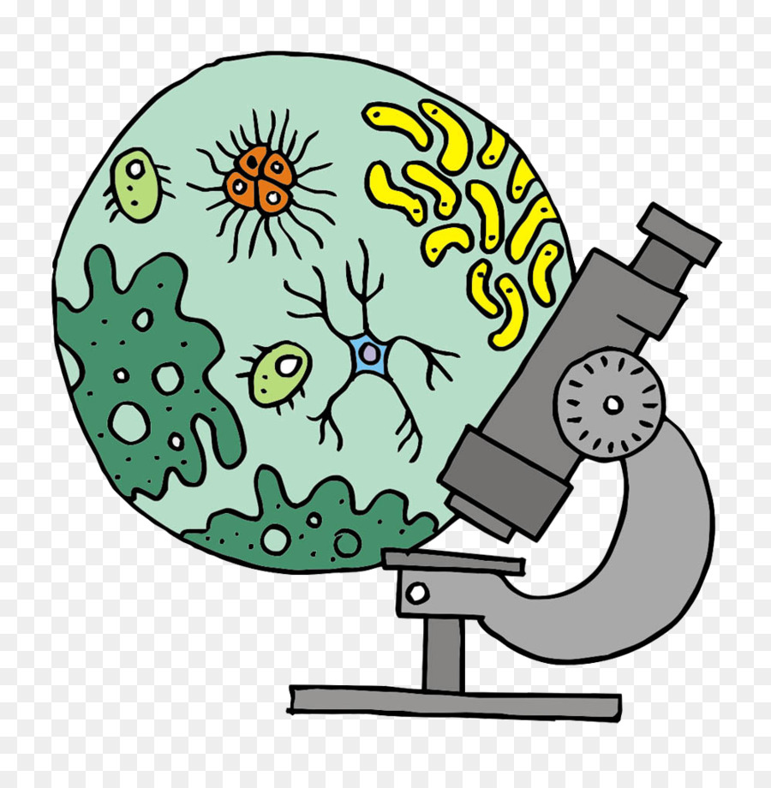
Microbiomes

Slide 3
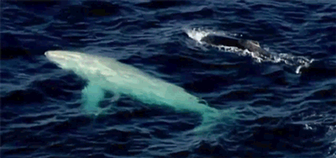
Life science is the study of living things. Life science, like all kinds of science, is not just the knowledge you can read about in books—it is also the process used to figure out that knowledge—so you will not just learn about life science, you will learn how to see and investigate the world like a life scientist.

Slide 4
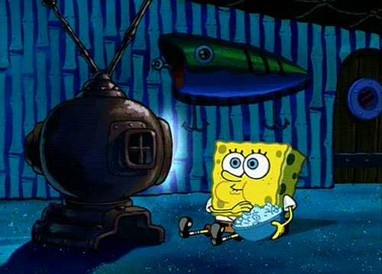
Let’s watch the video “The Campaign”

Slide 5
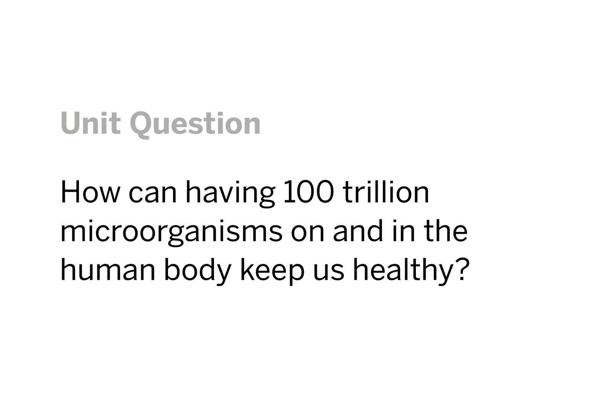
That is 130 times the world’s population living on & in your body!!

Slide 6
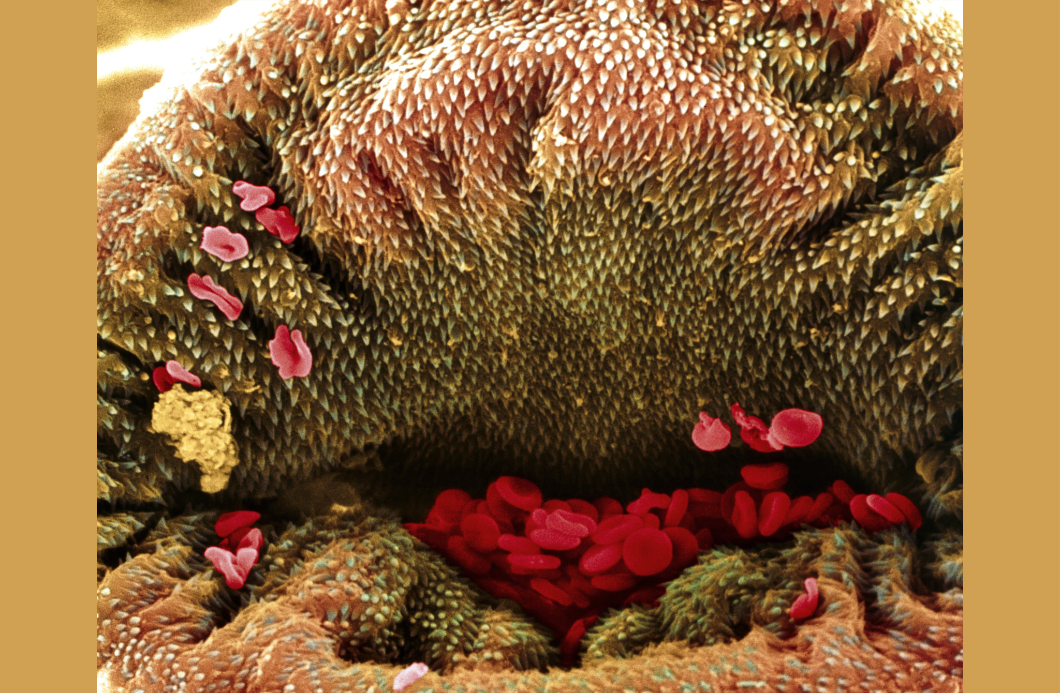
Thoughts??

Slide 7
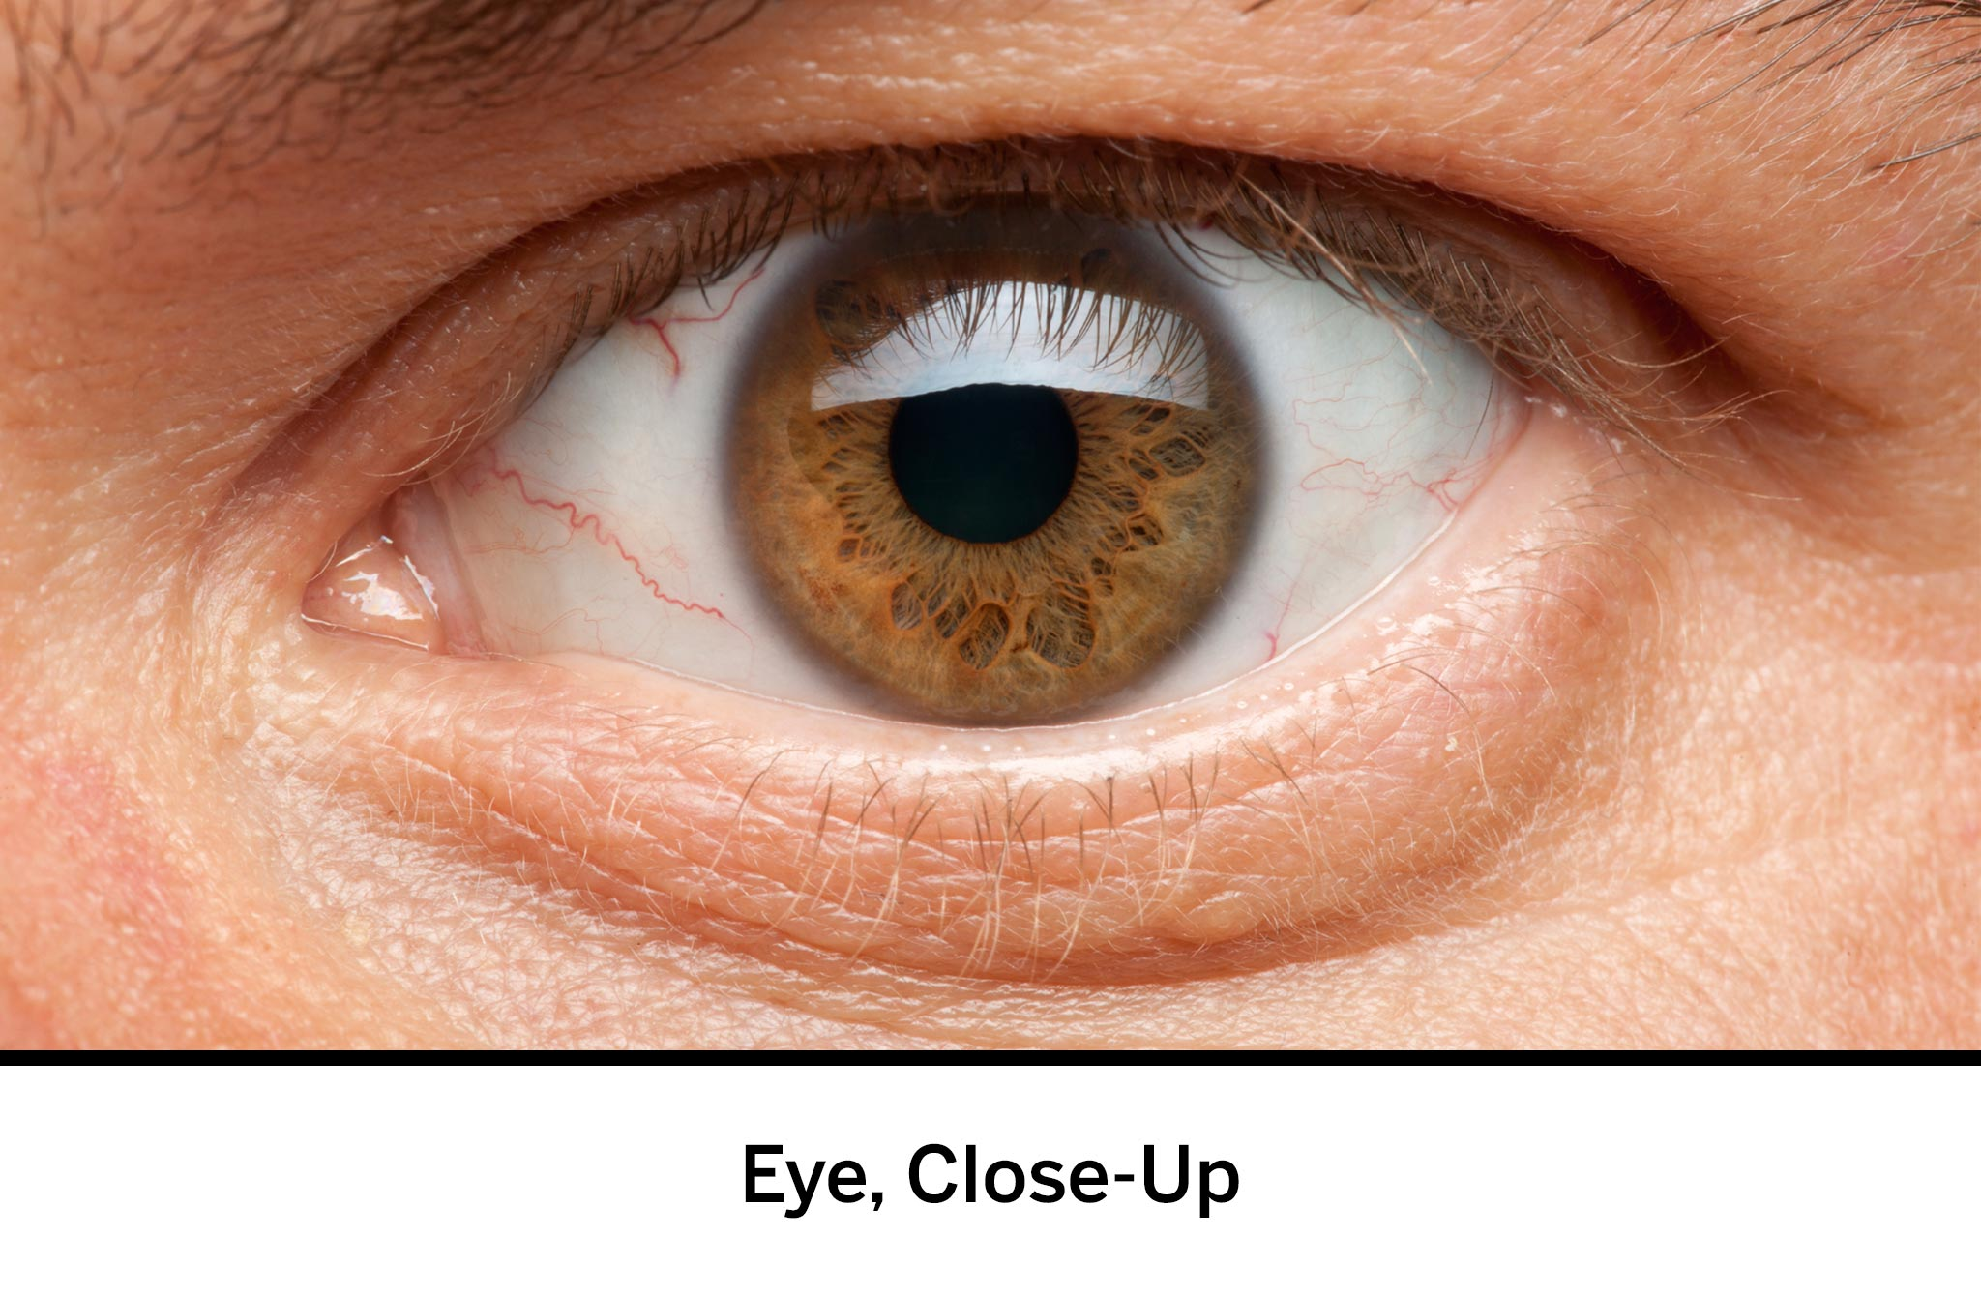
organisms: living things, such as plants, animals, and bacteria
scale: the relative size of things

Slide 8
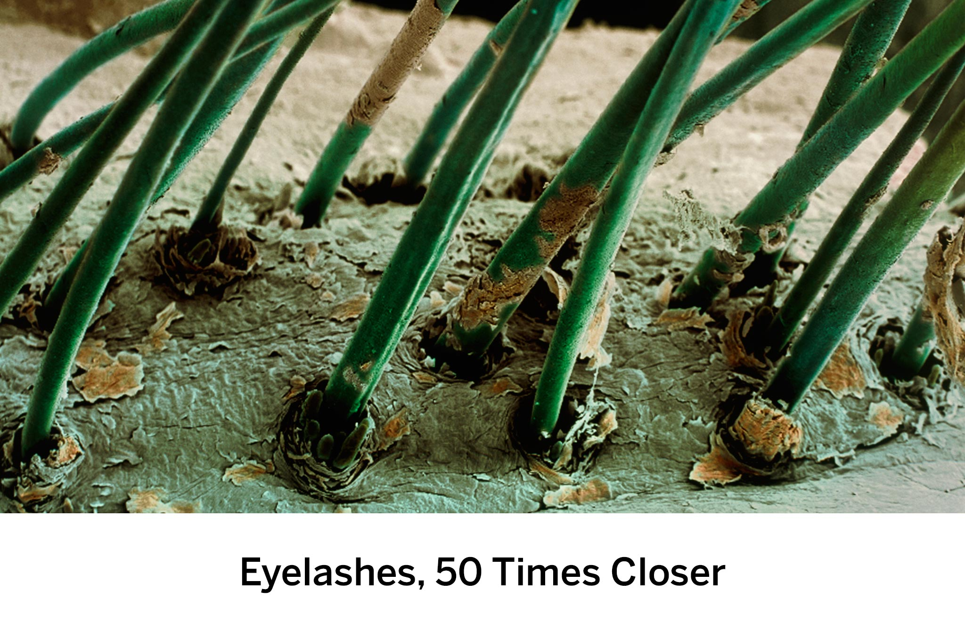

Slide 9
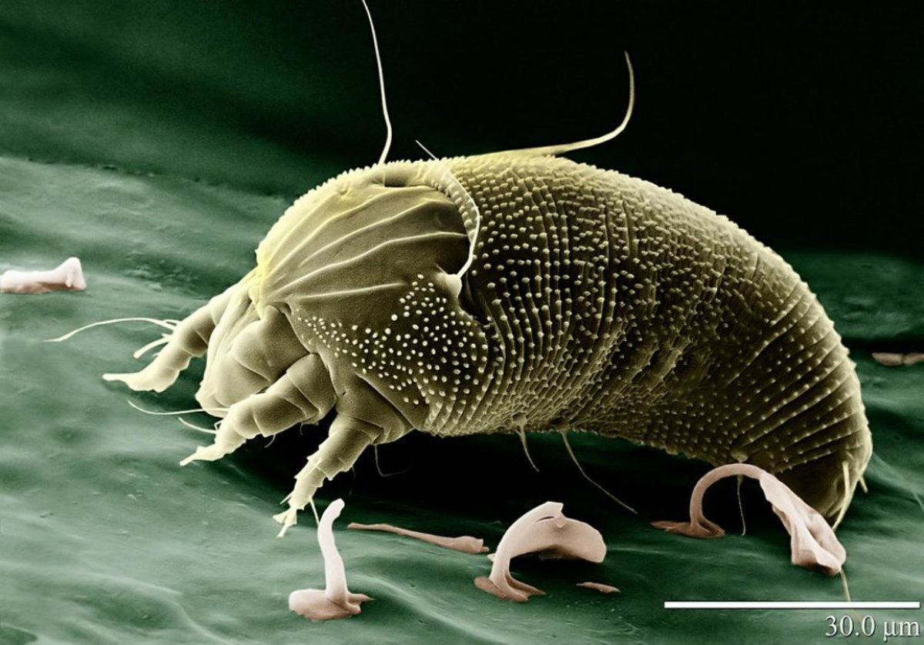

Slide 15
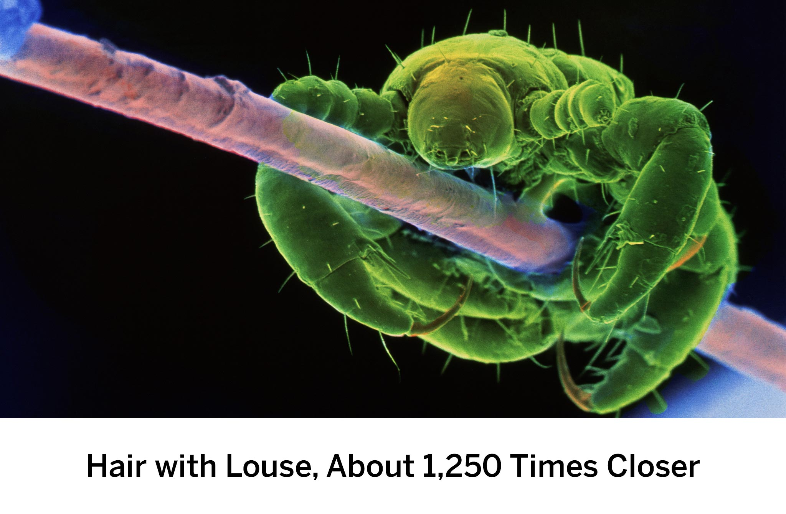
“Lice”☺

Slide 16
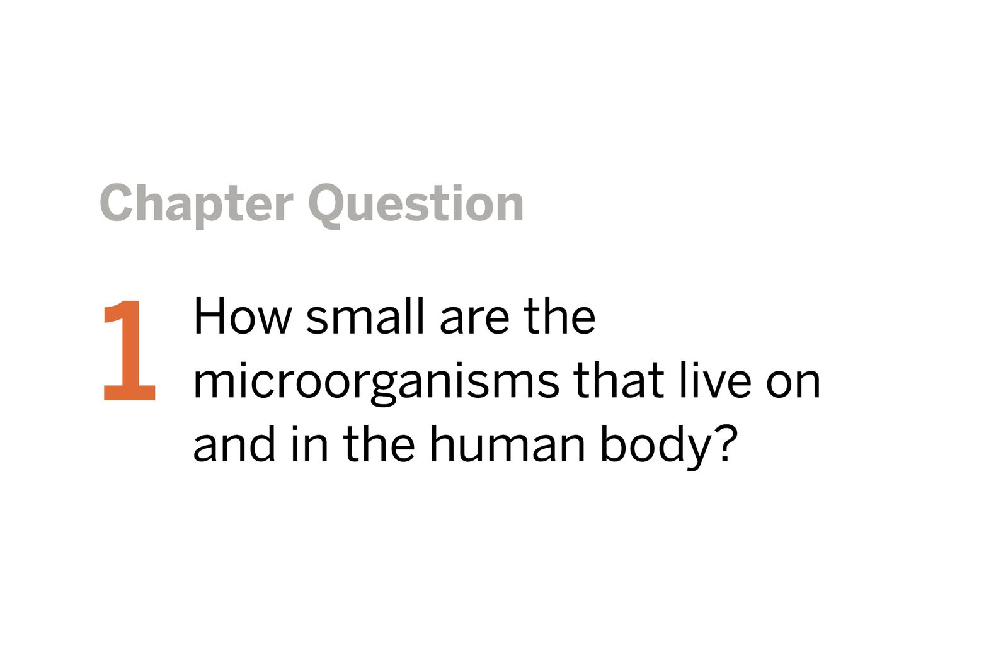

Slide 18
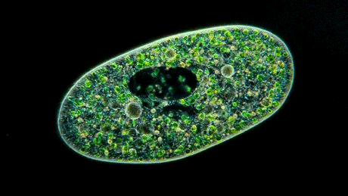
Page 1 1
microorganism: an organism that is too small to be seen with the naked eye

Slide 19
Page 2

Slide 20
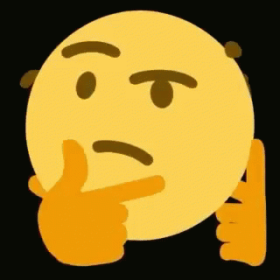
What initial ideas do you have about the Chapter 1 Question? Record some of your ideas below.
Don’t worry if you don’t have a lot of ideas yet. These are just your initial ideas about the question.
If you need help getting started, use some of the sentence starters below to help you record your ideas.
I think a microorganism is smaller than a . . .
I think this because . .

Slide 21
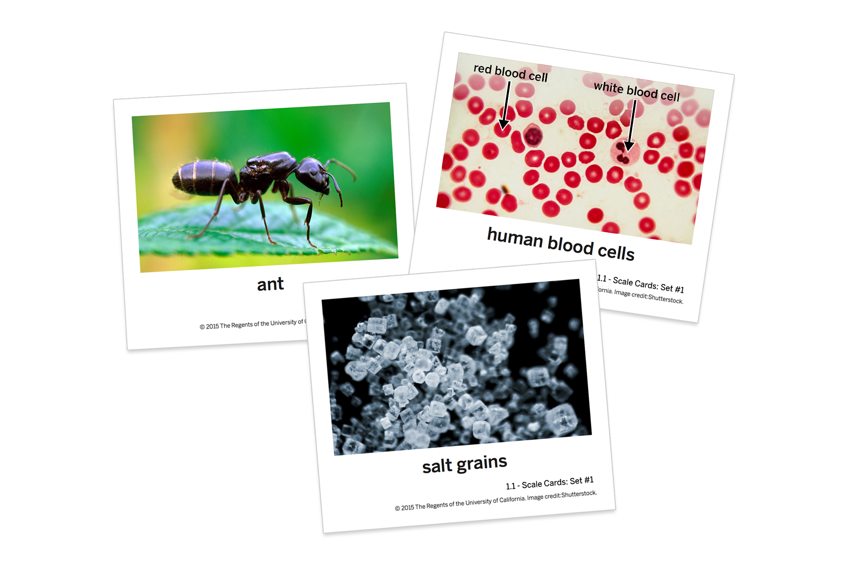
Completing the Scale Card Sort
Sort the organisms and objects on the
Scale Cards: Set #1 from smallest to largest (left to right).
**Remember to discuss
your ideas as you work!

Slide 22
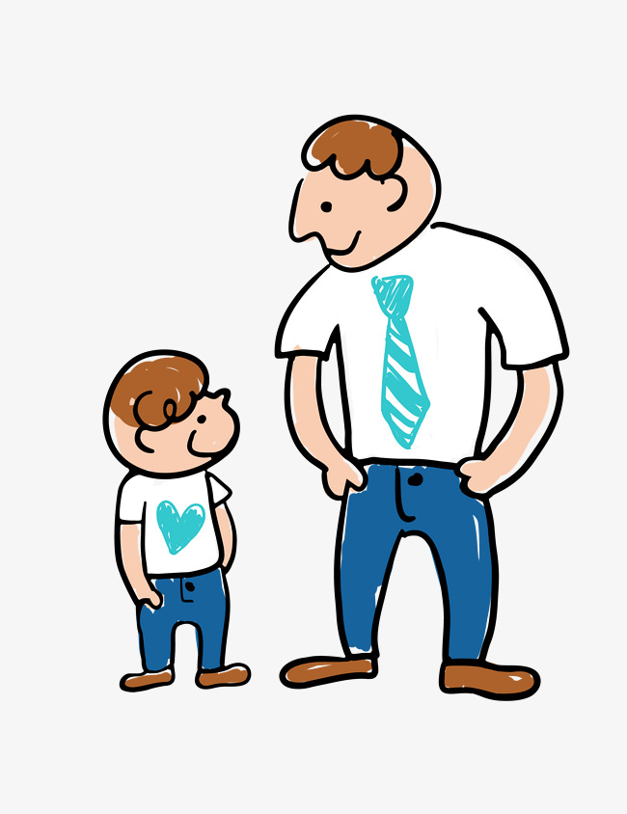
Scale-For example, an adult human is bigger than a child, but they are still a similar scale. The adult is not 10 or 100 times bigger than the child. However, a human is 1000 times bigger than a bacterium. And, a human is 100 times smaller than a redwood tree. The Scale Tool will give you a chance to explore these kinds of differences in scale.

Slide 23
Since the pictures are NOT to scale,
use the Scale Tool to correct your
card sort.

Slide 24
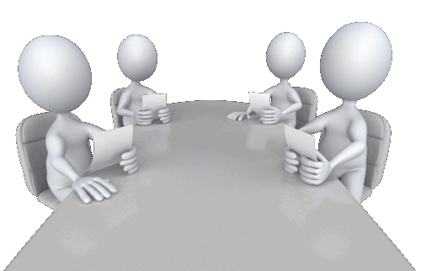
Is a red blood cell or a human skin cell smaller? How do you know?
Which objects can be seen with the naked eye? Which objects cannot be seen with the naked eye?
Were any of the objects hard to sort? Why?
What is the smallest object on the cards? Using what you discovered in the Scale Tool, name something even smaller.
RBC
Anything above 1 mm
When drawn they look the same size.
Water, smaller an electron

Slide 25
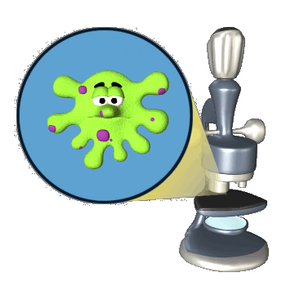
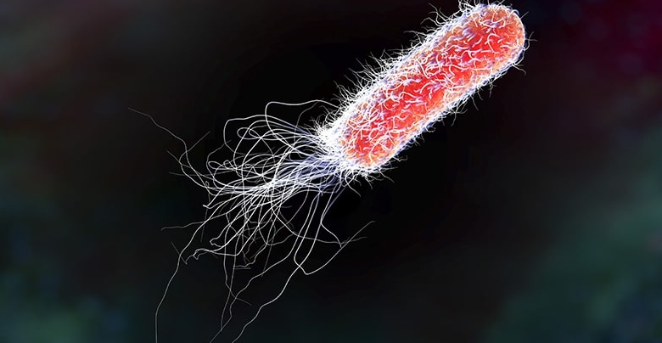
E.coli

Slide 26
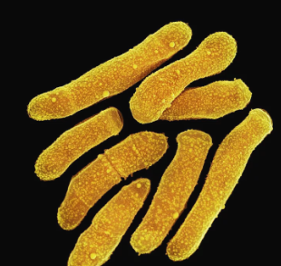
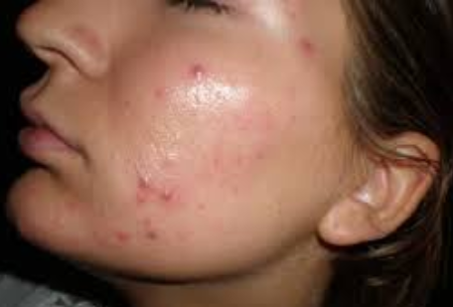
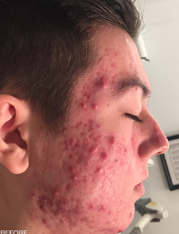
Most microorganisms are harmless or even beneficial
to us but….
Propionibacterium
acnes

Slide 27
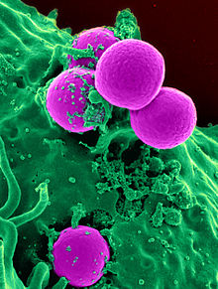
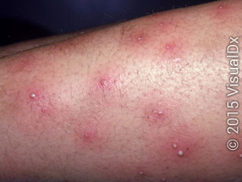
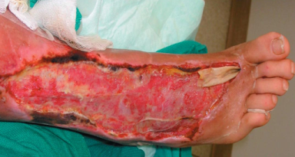
Most microorganisms are harmless or even beneficial
to us but….
MRSA

Slide 28
Practice
Final Sort
Below are some of the objects featured on the Scale Cards: Set #1.
Drag the objects to order them from smallest to largest (top to bottom).
Use the Scale Tool to help you order the objects, if needed.

Slide 29
The correct order, from smallest to largest, is
water molecule
E. coli bacteria
skin cell
grain of salt
human

Slide 30
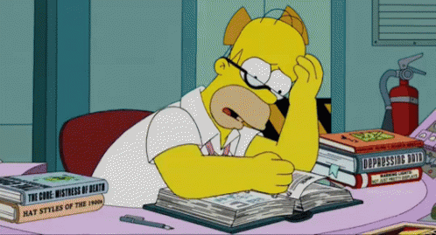
Reflecting About Microorganisms
Note: If you do not have access to Amplify Science at home, your teacher will provide you with an alternate way to complete this homework.
Respond to the two questions at the bottom of the screen. Try to use some of the words below that you heard today.
bacteria
cell
microorganism
microscopic
organism
scale
Answer the 2 Questions

Slide 31
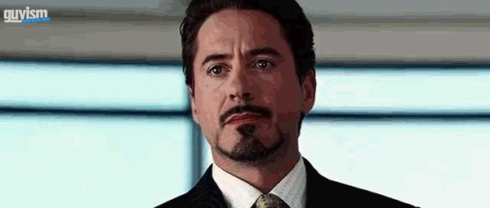
What was surprising or interesting to learn about the very small organisms and objects in today’s lesson?
2. What other questions do you have about microorganisms?

Slide 32
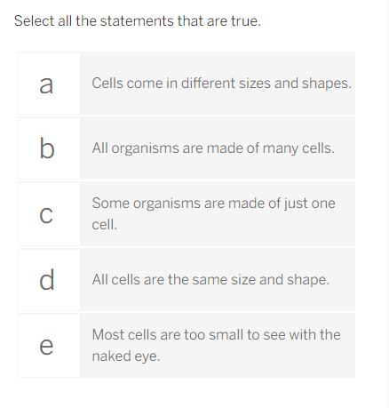
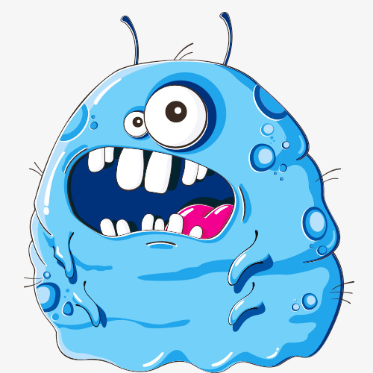
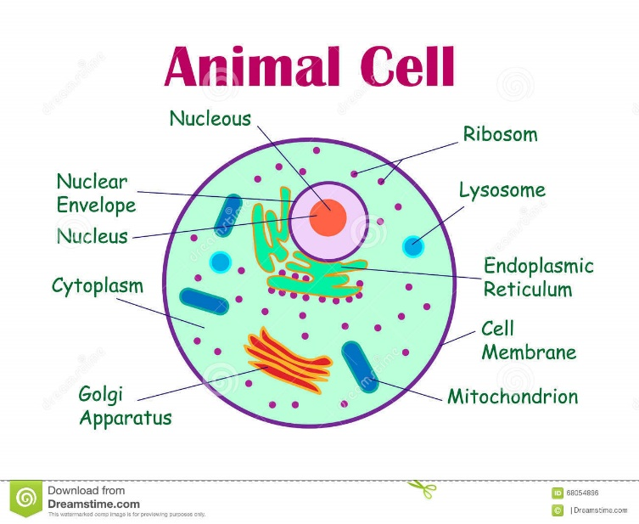
What else do you know about cells? Record your ideas or any questions you have about cells below.
Select all the statements that are true.

Slide 34
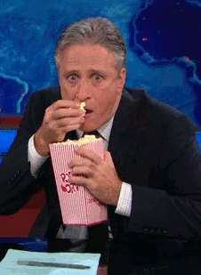
Let’s Watch “How Small is a Cell?”

Slide 35
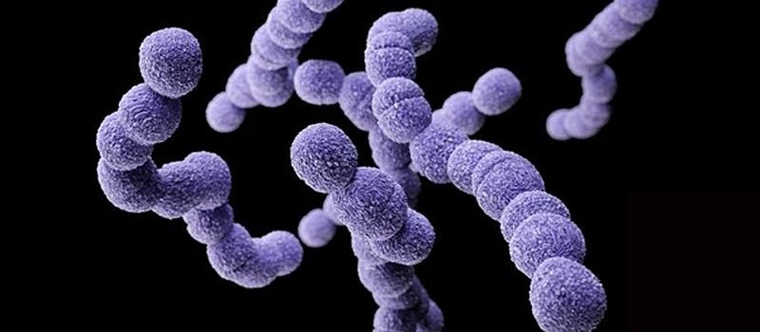
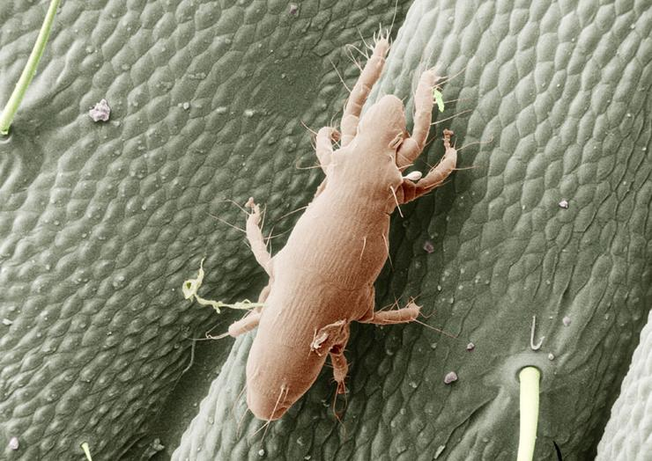
cells: the tiny structures that make up all living things and are the smallest units able to perform life functions
microscopic: too small to be seen with the naked eye
streptococcus
Flesh eating
Mite

Slide 36
Sorting Scale Cards: Set #2
Launch the Scale Tool to help you gather evidence about the objects on the new Scale Cards in Set #2.
Ringworm fungus
C. difficile bacteria
Human liver cell
You won’t find these items in the Scale Tool, but you can use the measurements on the Scale Cards: Set #2 and the measurements of other objects in the Scale Tool to help you place these items in the Scale Card Sort!

Slide 37
Quickly organize your cards…

Slide 38
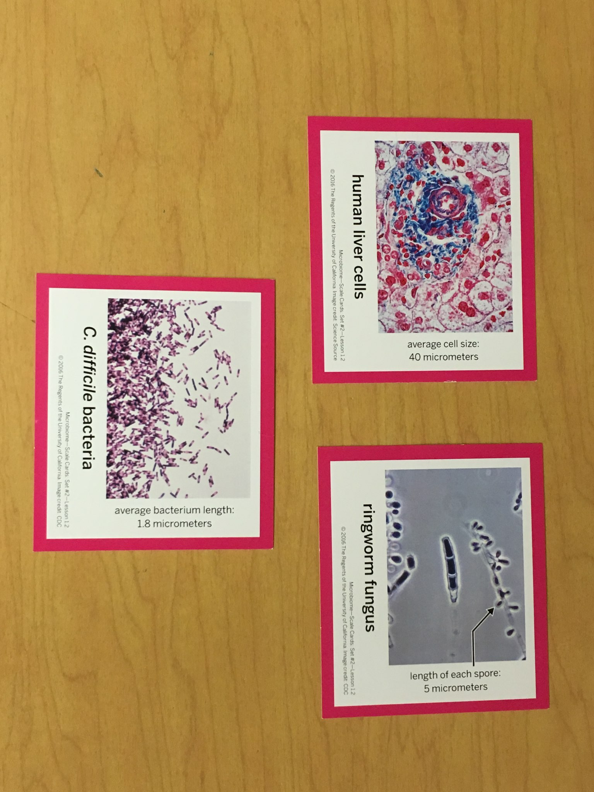

Slide 39
Solution!!
?
?
?

Slide 41
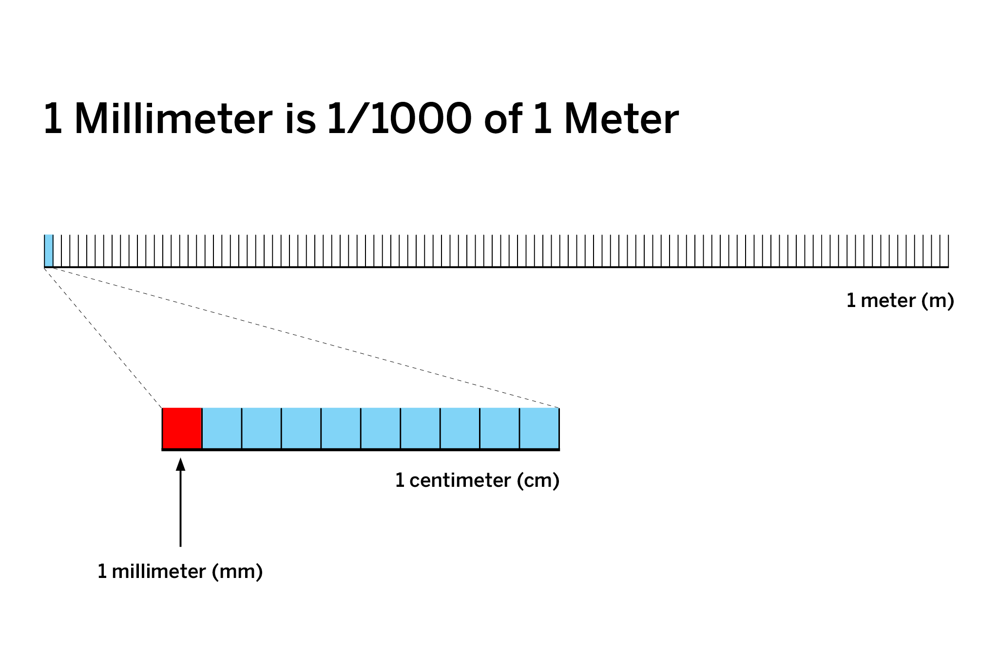
Microscopic things are really hard to imagine since we cannot see them with the naked eye. When life scientists study things that are too small to see, they often use a scale model. A scale model makes it easier to compare the sizes of microscopic things.

Slide 43
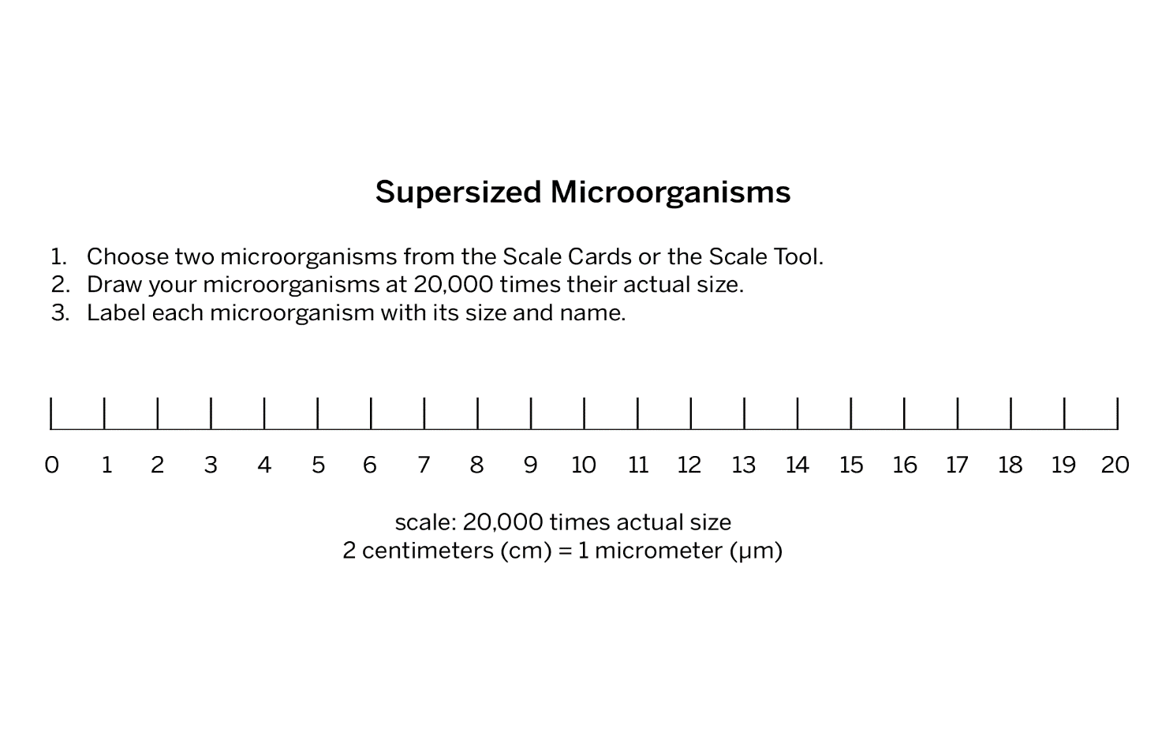
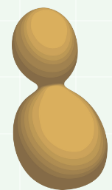
Supersized Microorganisms
Choose two microorganisms from the Scale Cards or the Scale Tool. Make a Scale Model of these microorganisms, where 2 centimeters = 1 micrometer.
Label the name and size of each microorganism
Yeast--3 micrometers
Mitochondria--4 micrometers

Slide 44
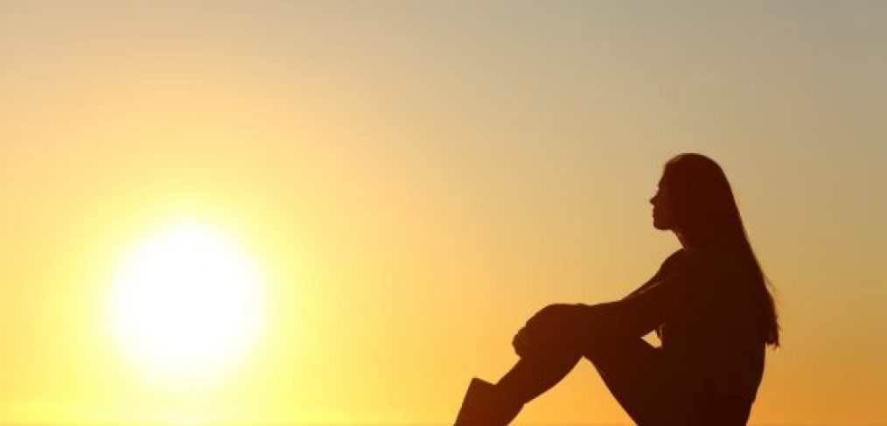
Today’s Warm-up
What else do you know about cells?
Reflection
Select all the statements
that are true.
Did any of your answers change from your Warm-Up response? If so, why? Record your changes and your explanations below.

Slide 45
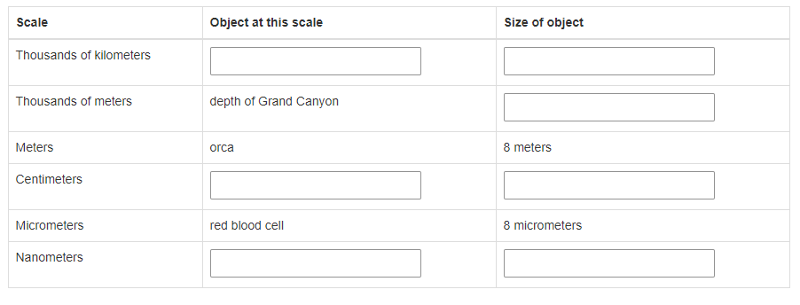
Comparing Objects of Different Scales
Note: If you do not have access to Amplify Science at home, your teacher will provide you with an alternate way to complete this homework.
Today, you learned the following:
Living things are made of cells.
Cells are very small—in fact, almost all cells are microscopic.
Some living things are made of just one cell.
Think about how the scale of cells compares to the scale of other objects. Launch the Scale Tool and complete the table below by finding examples of objects at each scale that is listed. Some parts of the table have been completed for you.

Slide 46
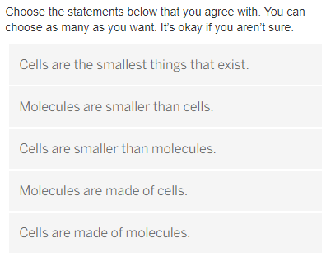
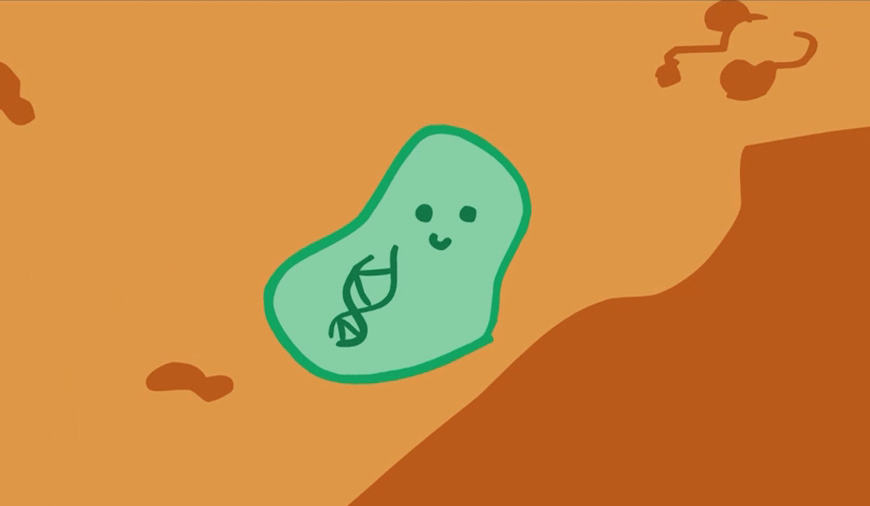
Warm-Up
You’ve been learning about tiny organisms that are made of a single cell! But are there objects even smaller than a cell?
Explain why you chose these statements.

Slide 47
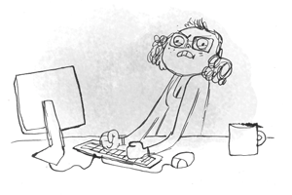
Supersized Microorganisms
Choose two microorganisms from the Scale Cards or the Scale Tool. Make a Scale Model of these microorganisms, where 2 centimeters = 1 micrometer.
Label the name and size of each microorganism
Yeast--3 micrometers
Mitochondria--4 micrometers

Slide 48
How can we know if molecules or cells are bigger? Well, we already know the size of cells, so if we knew the size of molecules, we could compare.
Remember, in order to be able to see them, we’ve drawn these single-celled microorganisms at 20,000 times their actual size. In our Scale Models, 2 centimeters equals 1 micrometer.
In the Warm-Up, you answered some questions about molecules. Sometimes, people get confused about the difference between cells and molecules. We learned that all living things are made up of cells, but what are molecules? What do you already know about molecules?

Slide 51
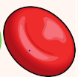

Slide 52
Adding Molecules to Your Scale Model
Cells are made up of molecules. You will now add representations of molecules on your Scale Model.
On one of your microorganism drawings, draw the smallest dot you can.
After you’ve discussed the scale of molecules with the rest of your class, label this dot to show how many molecules the dot represents.

Slide 53
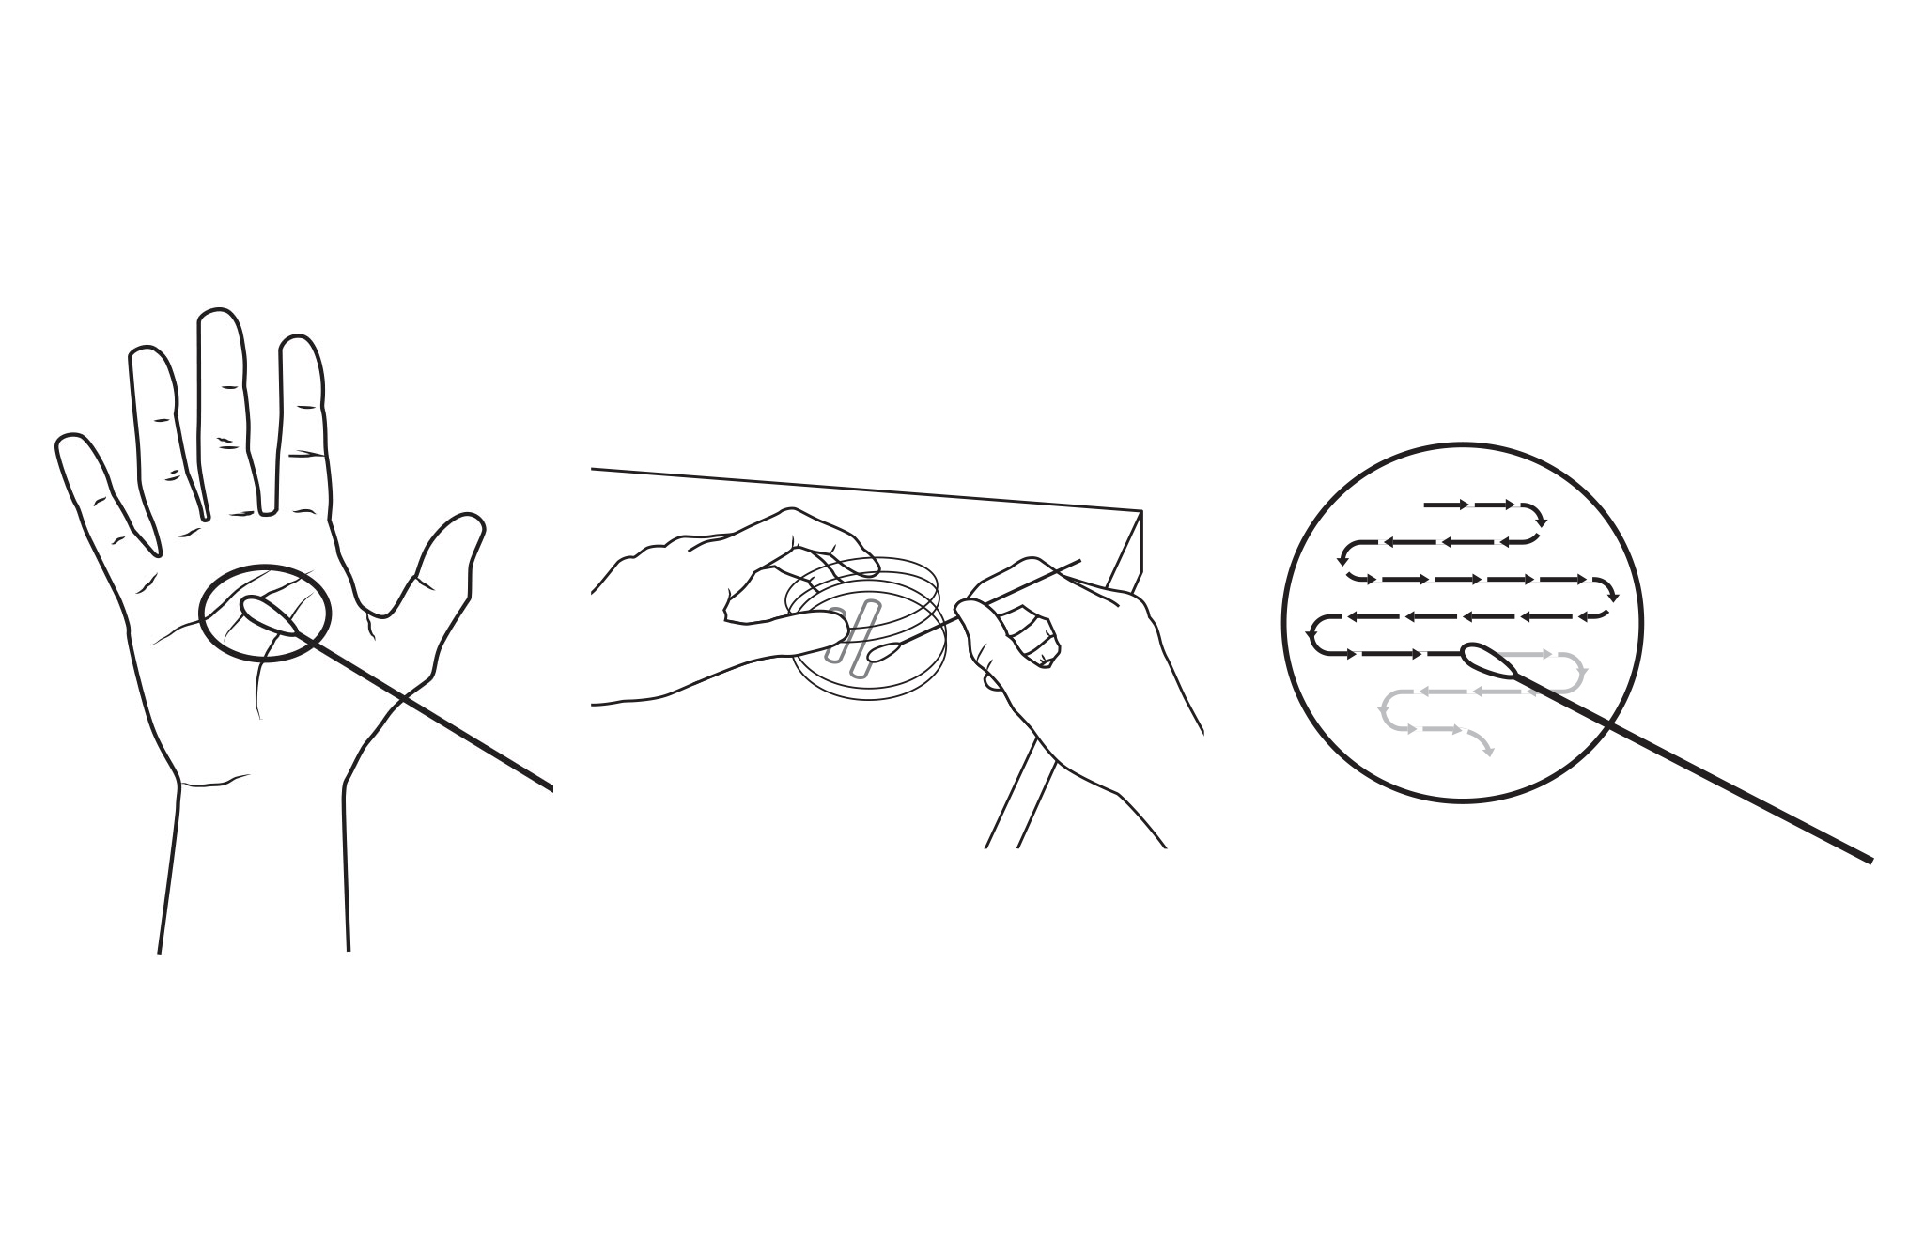
Observing Microorganisms
Can you observe microorganisms on your hand?
Do you think there are any microorganisms on your hand?

Slide 54
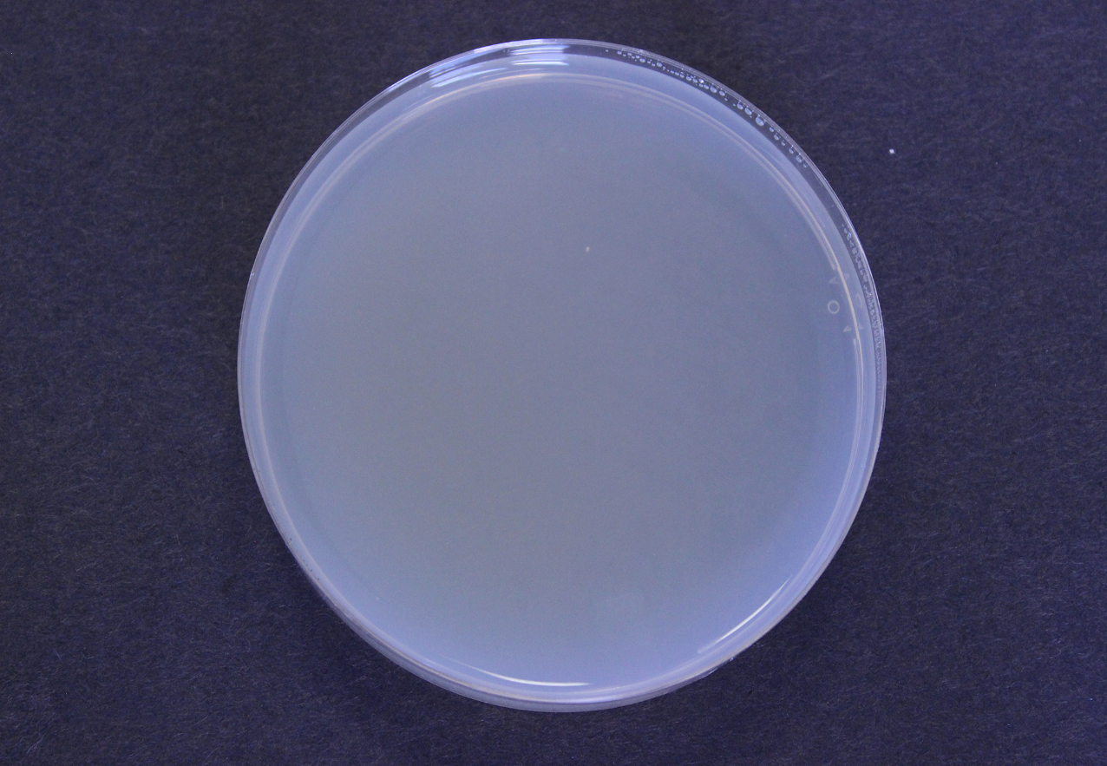
Observing Microorganisms: Day 1
Can you see evidence of microorganisms?
Describe what you observe in the petri dish.
Make a prediction: What do you think the petri dish will look like on Day 5?

Slide 55
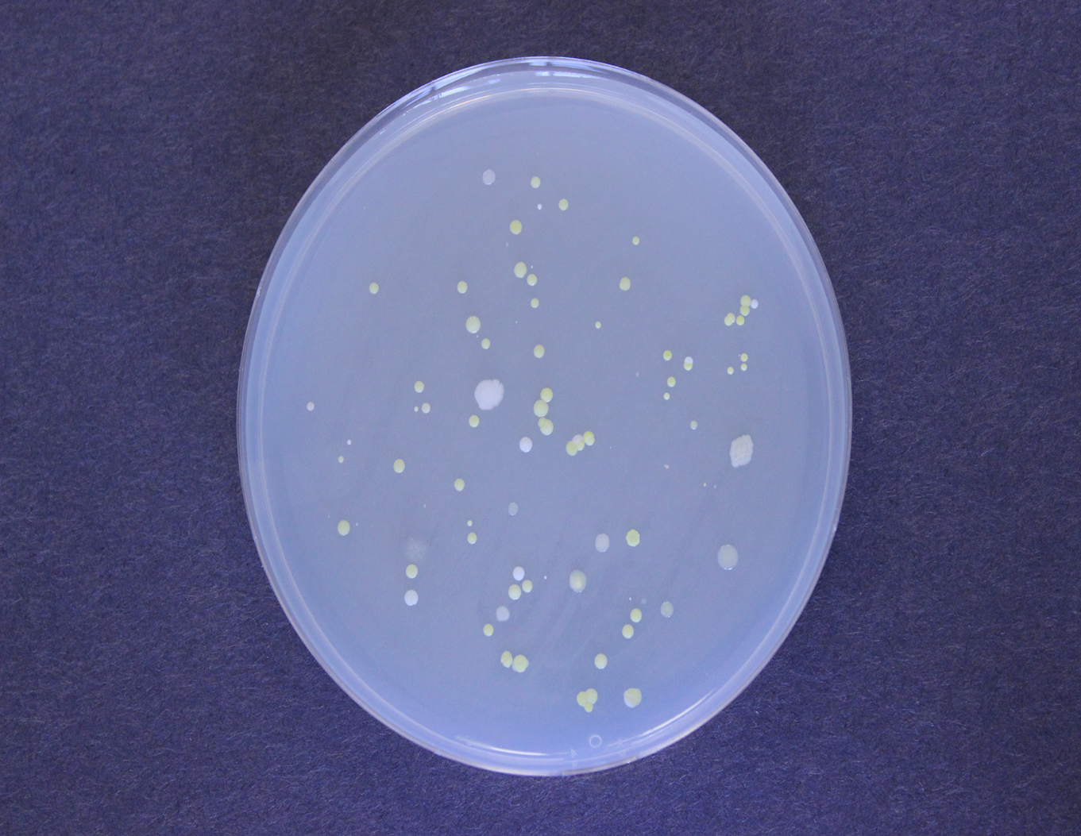
Observing Microorganisms: Day 5
Can you see evidence of microorganisms?
Describe what you observe in the
petri dish.
Make a prediction: What do you think
the petri dish will look like on Day 9?

Slide 57
Microorganisms
All microorganisms are made of cells
Cell

Slide 58
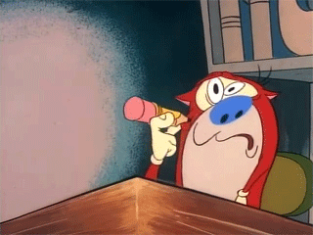
You and your partner
write 4
different sentences
on a piece of
notebook paper.

Slide 59
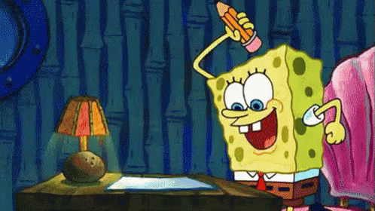
Read over your previous response to the Chapter 1 Question.
Revise your response so it includes what you have learned in the last few lessons. You may wish to use the following science words in your revised response.
*cell
*micrometer
* microorganism
*microscopic
*molecule
*nanometer

Slide 60
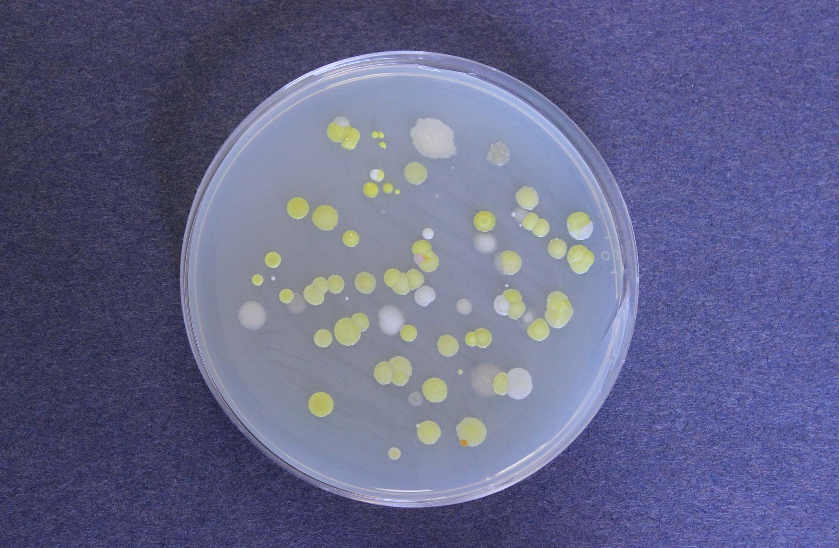
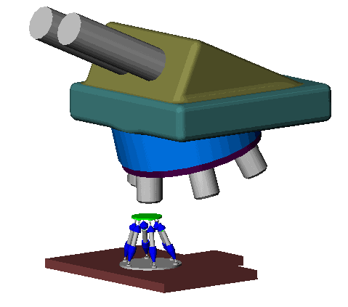
Can you see evidence
of microorganisms?
Describe what you observe
in the petri dish.

Slide 61
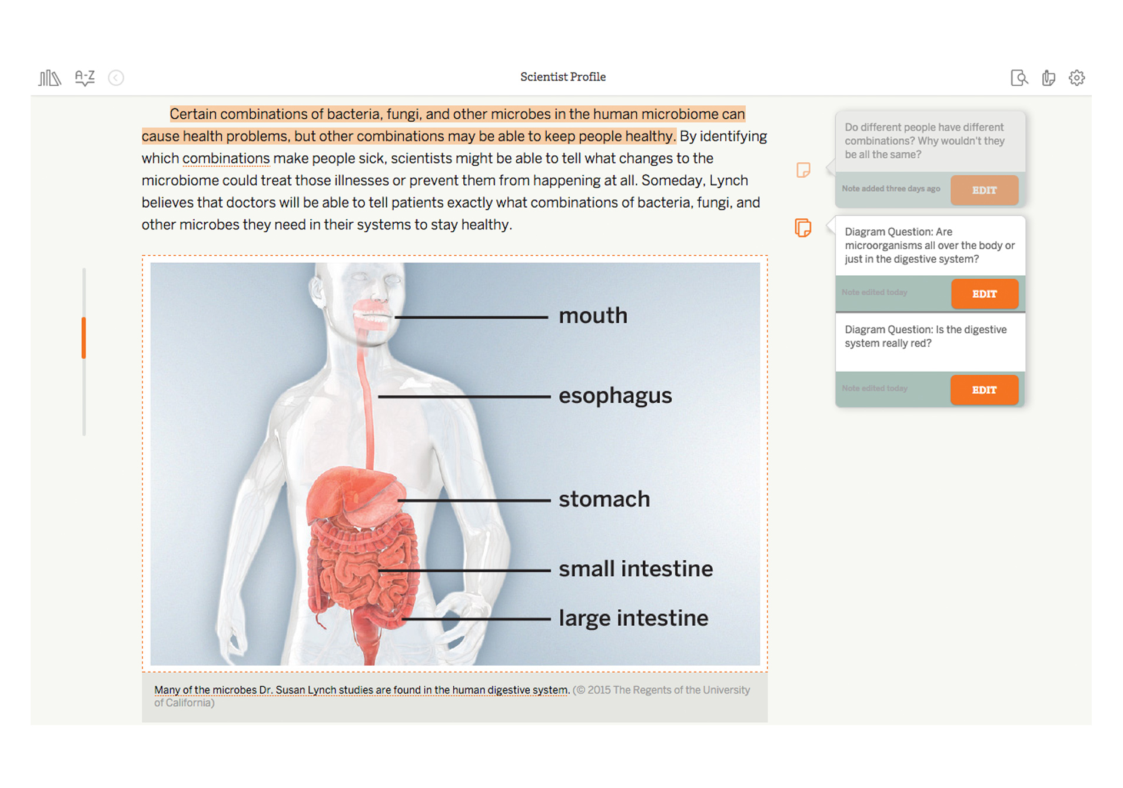
Introducing Active Reading
Analyzing Example Annotations
What do you notice about this student’s annotations?
How do you know that she was thinking carefully while reading and trying to understand the text?

Slide 62
The Human Microbiome A World Inside You There’s a world filled with strange creatures. The creatures of this world are invisible, and they’re not human. Aliens sometimes threaten to invade the world these creatures call home. This world is not a far-off planet: it’s your body! The creatures are called microorganisms, and your body is home to more than 100 trillion of them. Microorganisms live on your skin, in your gut, in your nose and mouth, and pretty much everywhere else on and in your body.

Slide 63
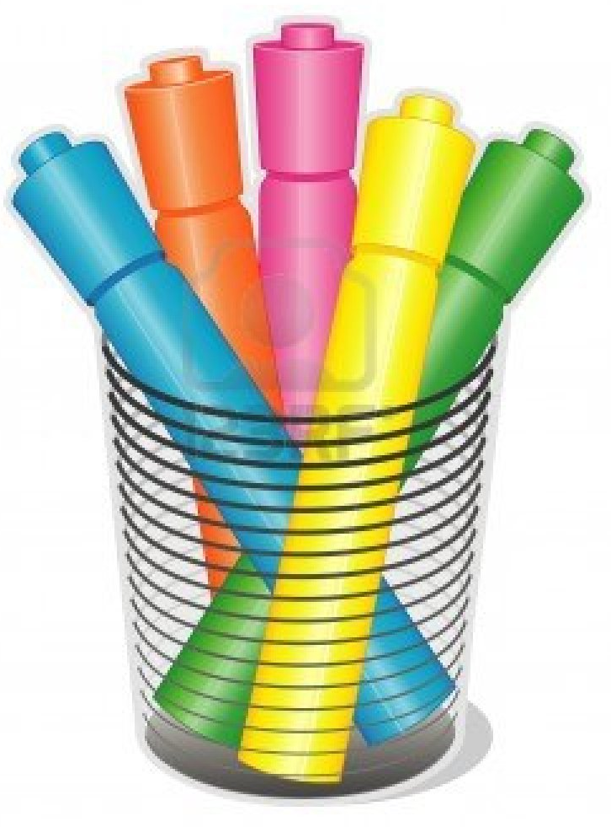
Active Reading Highlights
Yellow – Important detail
Pink – Confusing word or idea
Blue – Meaningful question
Orange – Making connections
Green – Main idea (Second read focus question)

Slide 65
Active Reading Highlights
Yellow – Important detail
Pink – Confusing word or idea
Blue – Meaningful question
Orange – Making connections
Green – Main idea (Second read focus question)

Slide 66
Beginning in the next lesson, you will use your new understanding of the human microbiome to help the Microbiome Research Institute figure out an important question about how the tiny organisms in one person’s microbiome can fight harmful bacteria in someone else’s body. Ultimately, our answer to this question will help the Microbiome Research Institute explain why they need more funding, as well.
Reflecting About Annotations
Review your annotations, answer the reflection questions below the article, and then press HAND IN to submit your article.

Slide 67
Warm-Up
After reading “The Human Microbiome” article, you learned that there are
trillions of bacteria in the human microbiome. Which of these statements do you agree with
most right now?
Bacteria are disgusting! Most bacteria in the human microbiome are harmful.
Bacteria are great! Most bacteria in the human microbiome are helpful.
I’m not sure! Bacteria are kind of disgusting, but some of them might be helpful.
What other interesting things did you learn from reading “The Human Microbiome” article?
Rhino
What questions do you still have
about the article?
Flu

Slide 68
bacteria: tiny organisms that are made of a single cell

Slide 70
Let’s Watch
“The Bill”

Slide 72
Case studies are important because they examine what happens to one particular patient. This analysis and data may then help explain why similar things have happened to other people. The case study that you will be analyzing will help explain why fecal transplants save lives.

Slide 74
Analyzing Data in Pie Charts
Annotate the case study pie charts below with your comments and questions.
Then, discuss the following questions with your partner:
What is the same about the patient’s gut microbiome data from week 1 to week 3?
What is different about the patient’s gut microbiome data from week 1 to week 3?
When you are finished discussing with a partner, answer the questions about the patient at the bottom of the screen.
After your discussion, record your ideas below about why you think Patient 23 feels normal during week 1 but sick during week 3.
The evidence that supports my ideas is . . .

Slide 75
When scientists try to answer questions they use data, like the case study you just analyzed. But, they also use information from texts to help them make sense of data. We are going to return to “The Human Microbiome” article because it might have information that could help us answer our questions about Patient 23.
Second Read
In this class, when you read a text for the first time you will be reading to understand the text. You will always talk about the text with your classmates and try to help one another better understand the ideas in the text. Today, we will do a second read; we will return to the article we have already read with an important purpose for rereading.
Focus--We need to understand why Patient 23 felt normal during week 1 but sick during week 3. What might that have to do with his gut microbiome?

Slide 76
Active Reading Highlights
Yellow – Important detail
Pink – Confusing word or idea
Blue – Meaningful question
Orange – Making connections
Green – Main idea (Second read focus question)

Slide 77
Was the article helpful? Why or why not?

Slide 78
Use what you learned from your second read of “The Human Microbiome” article (below) to revise your explanation about why Patient 23 felt sick during week 3.

Slide 79
Which of these arguments is more convincing? Explain your thinking below.
Warm-Up
Read the arguments below.
Then, answer the question about the arguments.
Argument One: Patient 23 felt sick during week 3 because he was infected with the C. jejuni bacteria. From “The Human Microbiome” article, I know that “this kind of C. jejuni infection can cause diarrhea, vomiting, and fever—all the symptoms of food poisoning.” These symptoms match the doctor’s note for Patient 23 for week 3. When Patient 23 felt healthy during week 1, the C. jejuni bacteria was not present in his gut microbiome. In week 3, when he felt sick, C. jejuni was present. Therefore, C. jejuni is probably the cause of his sickness. Argument Two: Patient 23 felt sick during week 3 because he was infected with the C. jejuni bacteria. C. jejuni is very bad for you. He probably ate something spoiled. My sister got food poisoning once.

Slide 84
claim: a proposed answer to a question about the natural world
evidence: information about the natural world that is used to support a claim
reasoning: the process of making clear how your evidence supports your claim

Slide 85
Do both arguments have a claim that answers the question?
Do both arguments have evidence that supports the claim?
Do both arguments explain how the evidence supports the claim?
[Yes, they have the same claim.]
[Argument One includes several pieces of evidence that support the claim. Argument Two has some information, but it does not support the claim.]
[Argument One does. Argument Two does not.]

Slide 87
We have a lot of evidence that supports the claim that Patient 23 was infected with C. jejuni. As you will see in the next set of case study data, Patient 23 was treated with antibiotics after week 3. To continue our work for the Microbiome Research Institute, we will want to focus on antibiotics, and, in particular, this question: How do antibiotics affect the microbiome?

Slide 88
Now, we are going to look at some evidence to see if this claim is supported.
One thing scientists need to do when they are making an argument is to evaluate evidence in order to see if it is relevant to the question they are investigating. Relevant means that the evidence addresses the question and can help scientists decide whether or not the claim is supported. A strong argument should not include irrelevant information or information that does not relate to the question and claim.

Slide 91
Antibiotics Card Sort
How do antibiotics affect the microbiome?
Place the Claim card at the top of your desk and the Relevant and Irrelevant headers underneath it.
With your partner, discuss each evidence card and decide if it is relevant or irrelevant to the claim.
Place each evidence card under the appropriate header on your desk.
Explain why you placed the card under the relevant or irrelevant headings on a piece of notebook paper.

Slide 92
Did you find evidence that supported
the claim?
Were any difficult to sort? Why?
Make sure you use only relevant
evidence.

Slide 93
What will happen to Patient 23’s gut microbiome after his antibiotics treatment?

Slide 94
Observe what happened to Patient 23 during week 5 (after he was treated with antibiotics).
What do you notice? How do you think antibiotics affected his microbiome?

Slide 95
Reading “Meet a Scientist Who Studies the Human Microbiome”
What do scientists who study the human microbiome hope to achieve?

